Slide 1
The Formal Elements of Art
Notes:
https://www.youtube.com/playlist?list=PLKmoVoqeac43A3xz4570IFozxWkiW_yjn

Slide 2
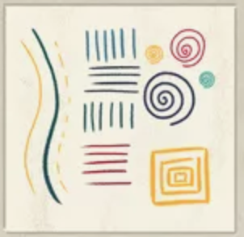
Y1
Line

Slide 3
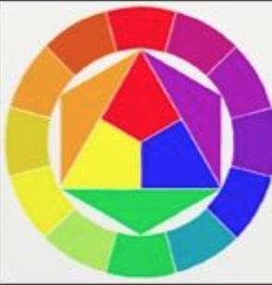
Y2
Colour

Slide 4
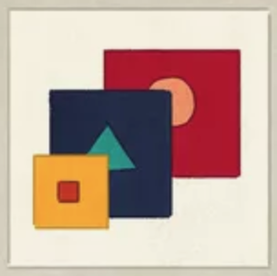
Y3
Shape

Slide 5

Y4
Tone

Slide 6
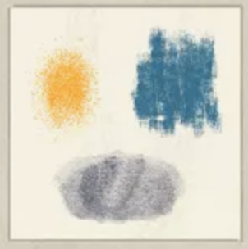
Y5
Texture

Slide 7
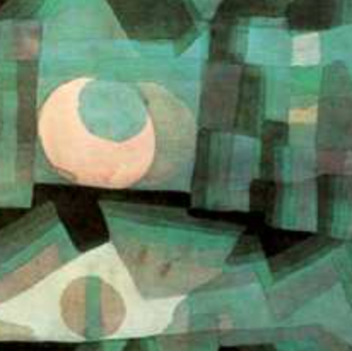
Y6
Pattern

Slide 8
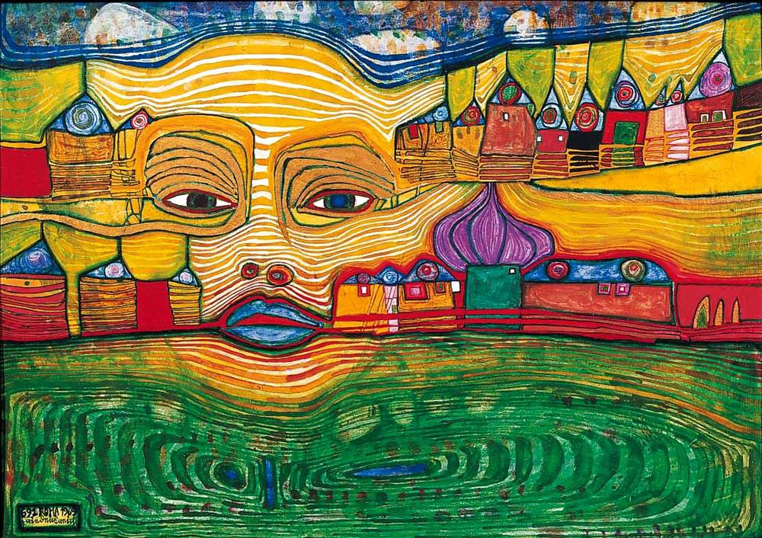
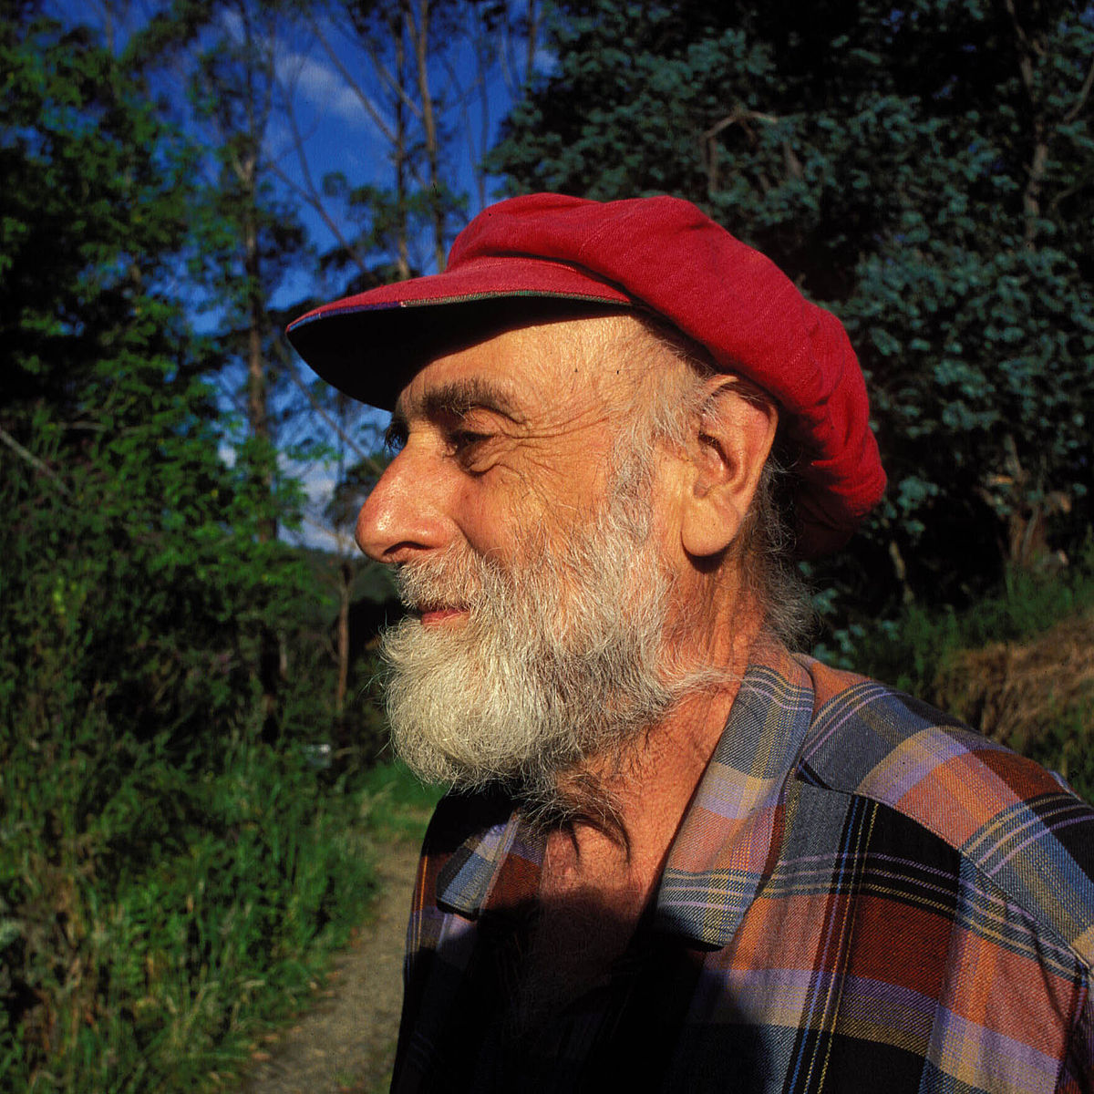
FRIEDENSREICH HUNDERTWASSER

Slide 9
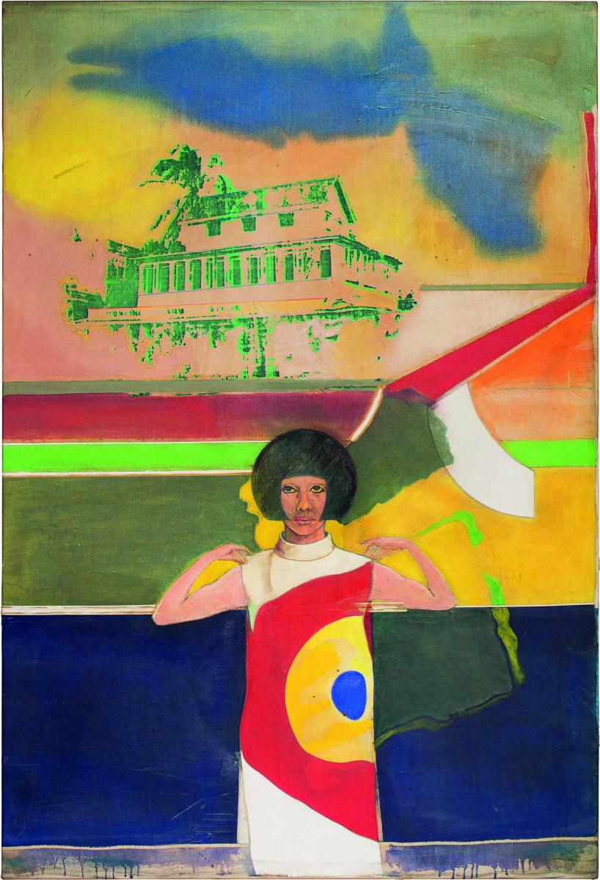
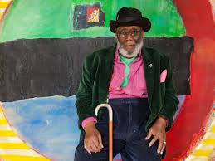
FRANK BOWLING

Slide 10
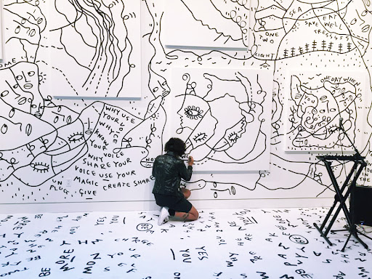
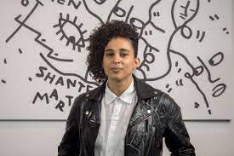
SHANTELL MARTIN

Slide 11
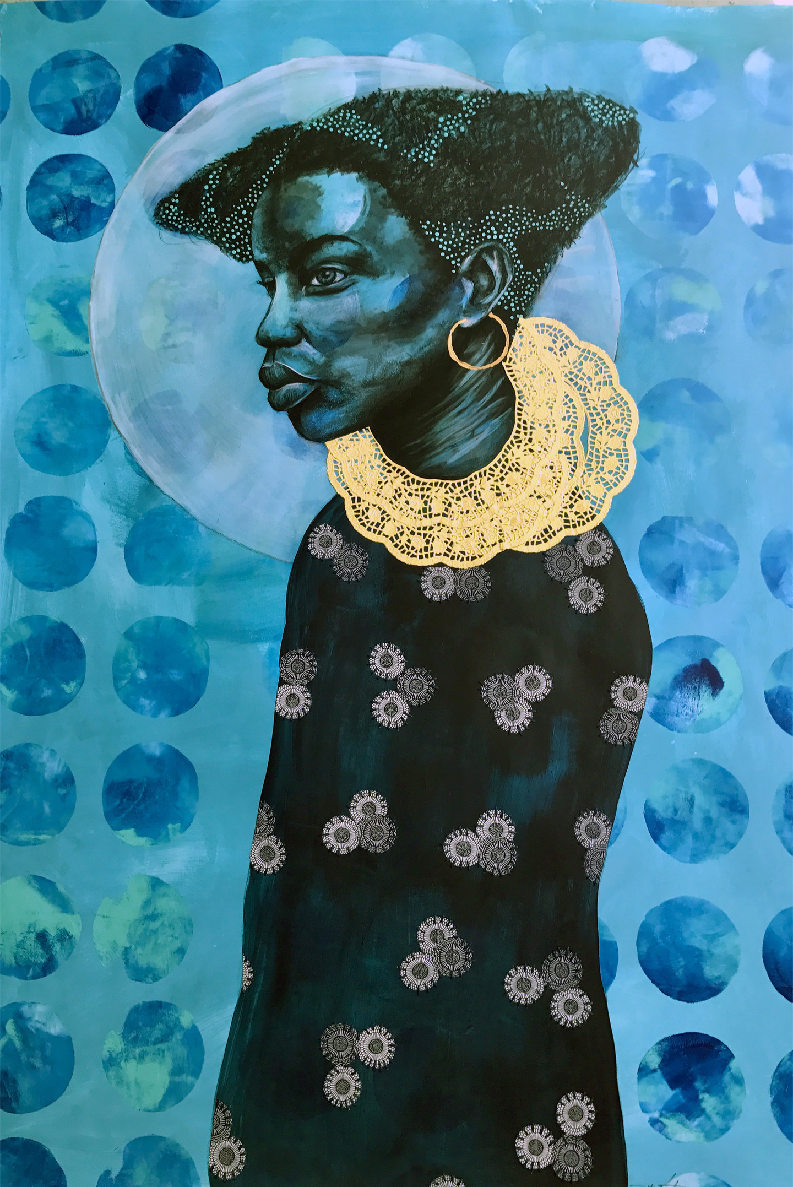

DELTA MARTIN

Slide 12
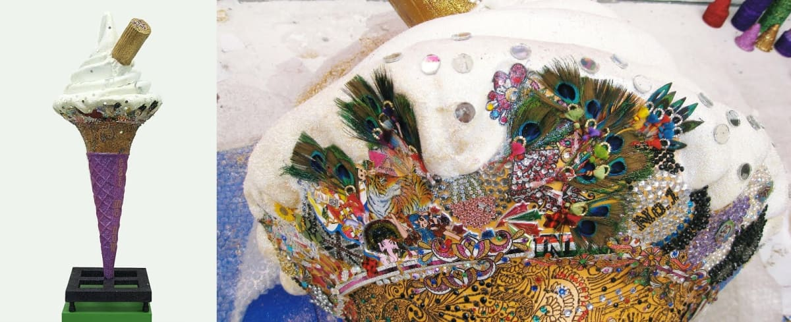
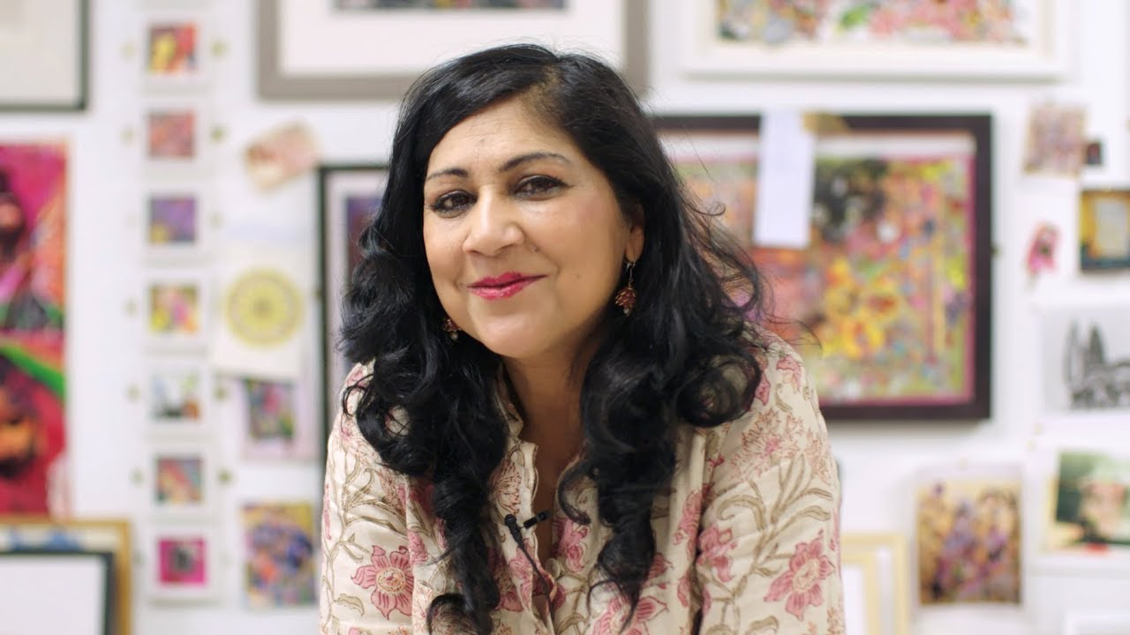
CHILA KUMARI SINGH BURMAN

Slide 13
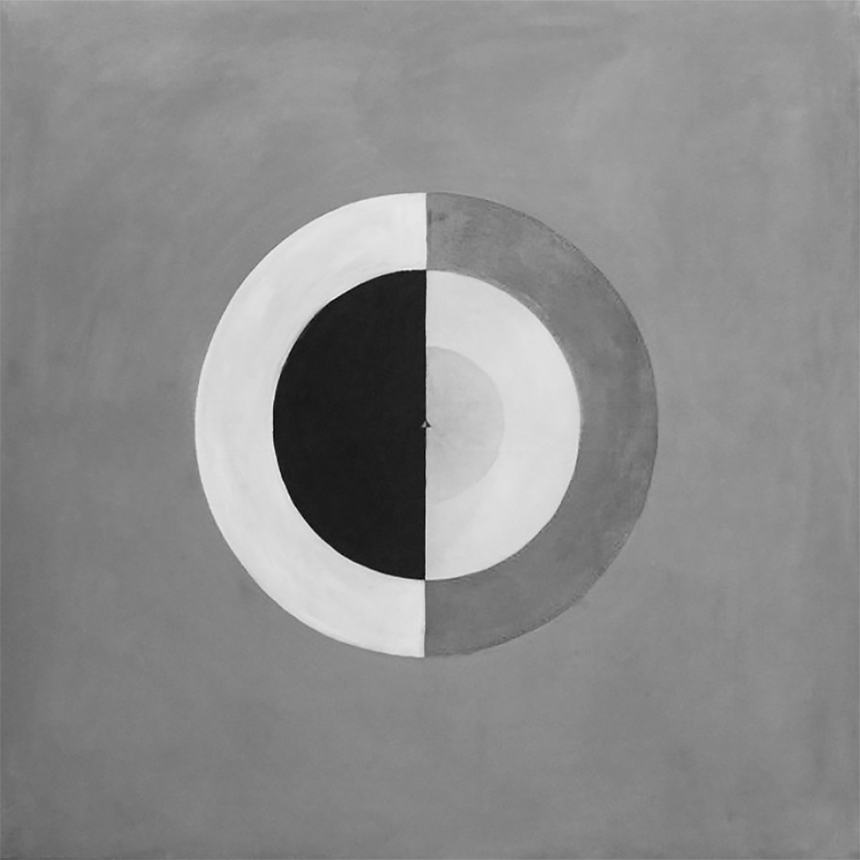
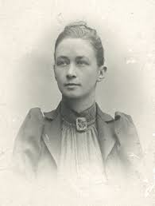
HILMA AF KLIMT

Slide 14
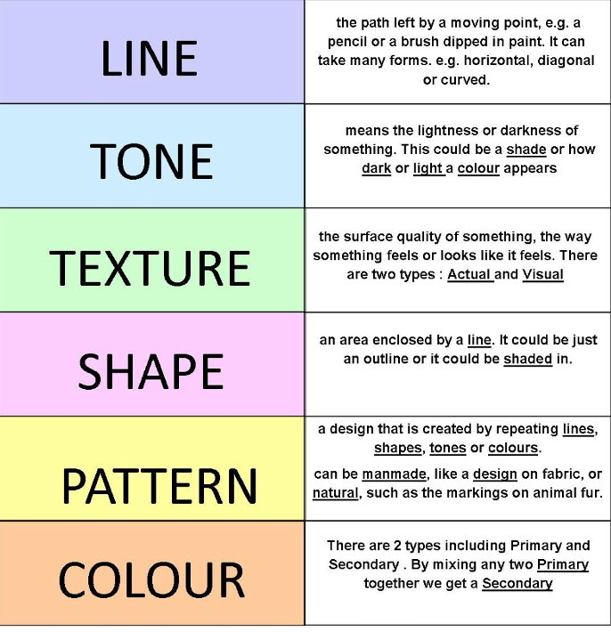

Slide 15
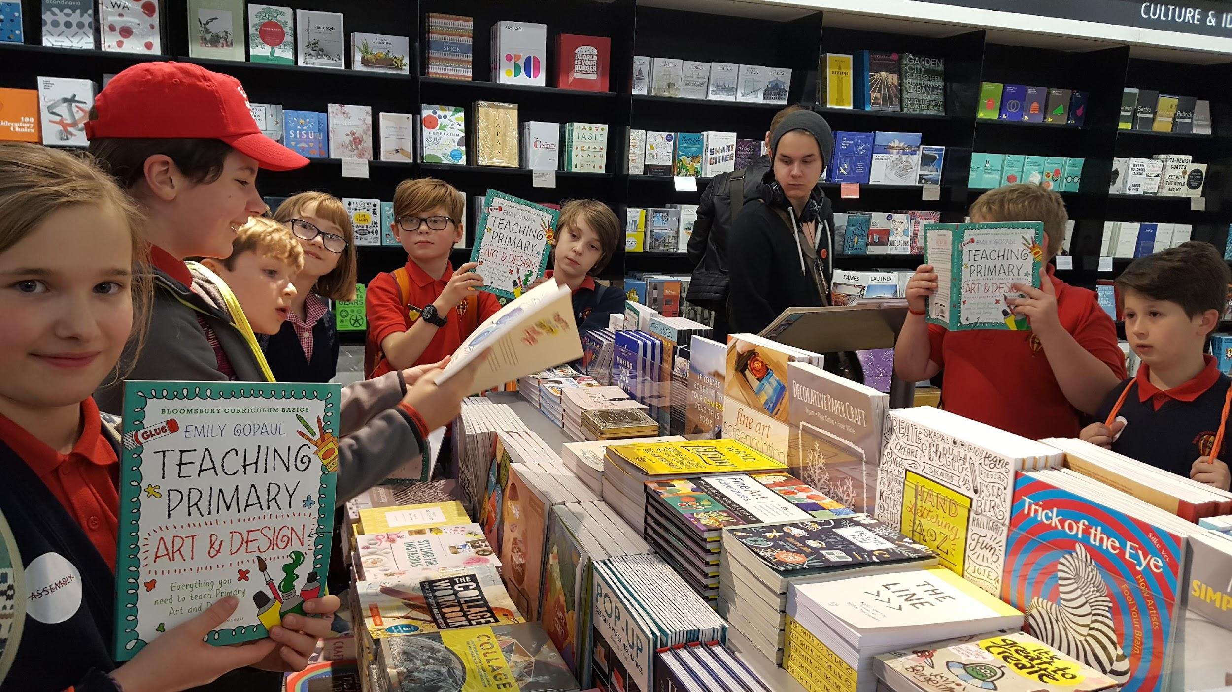



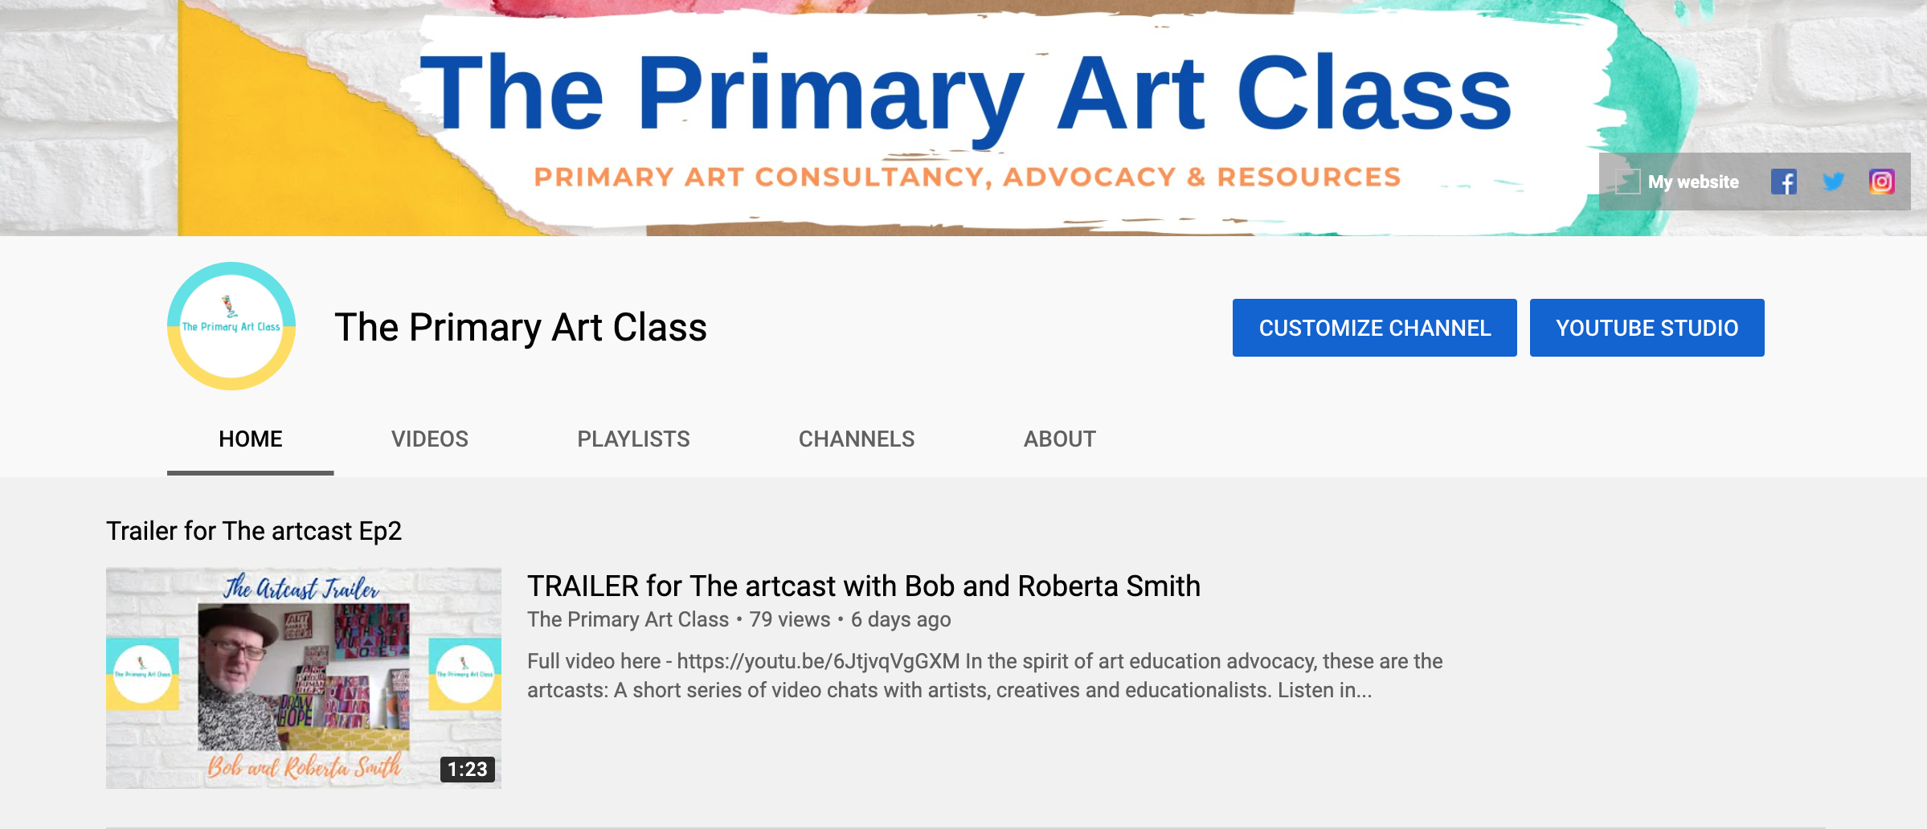

Stay in touch…
The Primary Art Class
emily@theprimaryartclass.com

