Slide 1
British soldiers with objects looted from the royal palace during an expedition to the Benin Empire in 1897.
Notes:
Ask students to ‘read’ the photograph using open and closed questions
Reveal the text and discuss

Slide 2
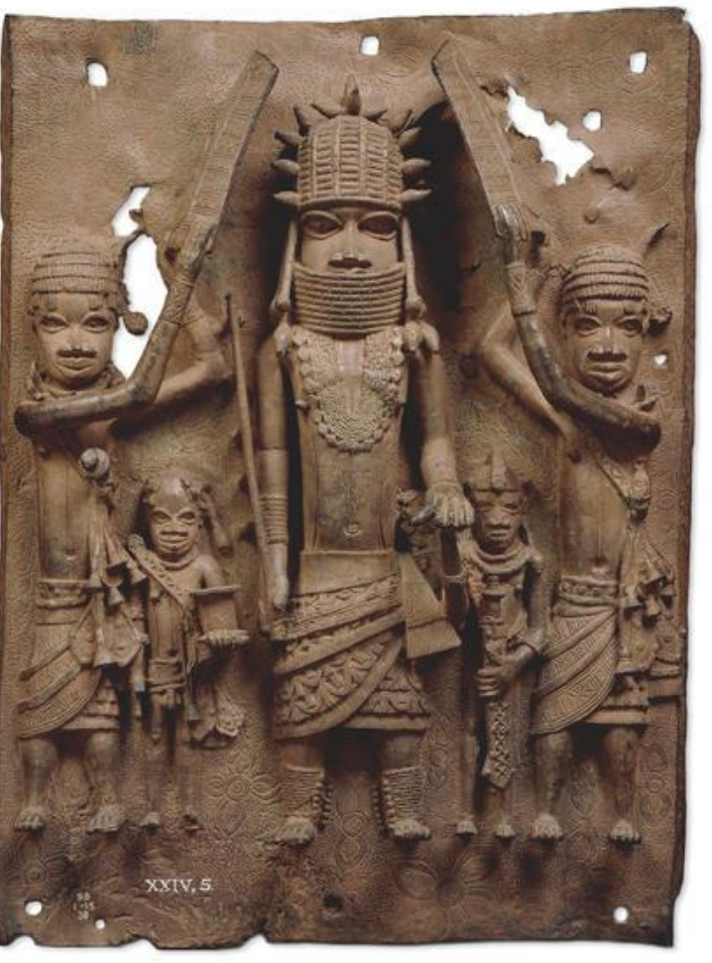
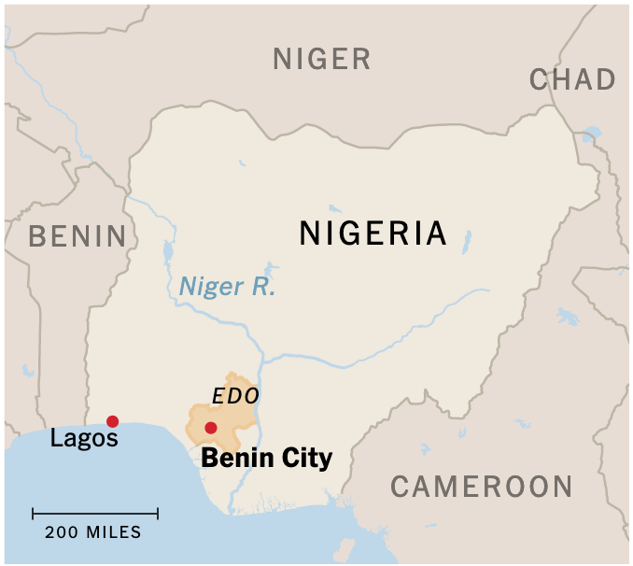
Brass plaque showing the Oba of the Kingdom of Benin
16th century AD
Benin was a very successful Empire but the kingdom came to a sudden end in 1897, when a British army invaded and made it part of the British Empire.

Slide 3
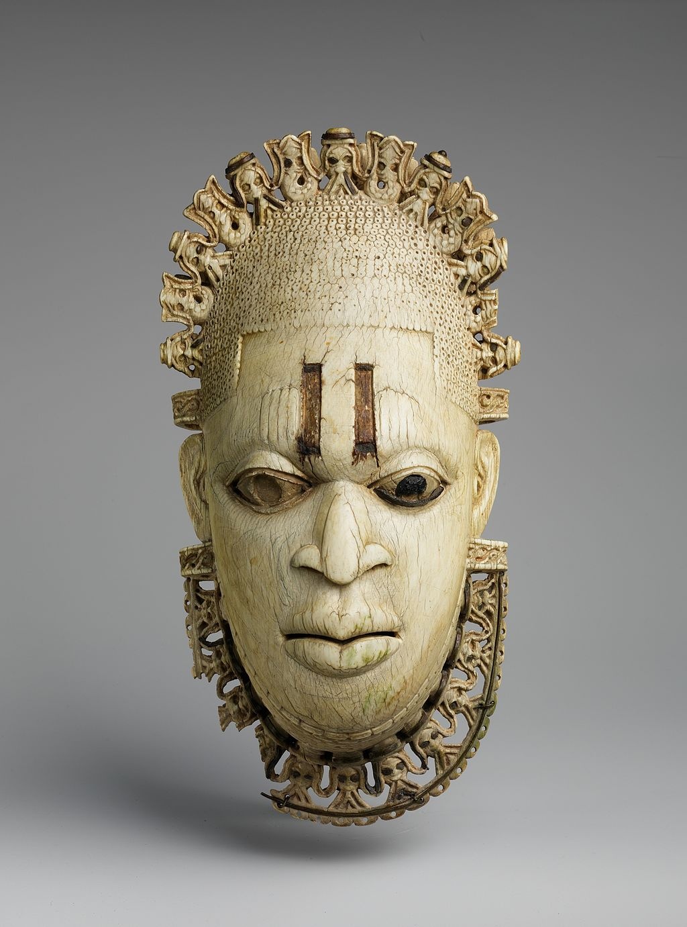
These sculptures of antiquity can be compared with the best of Italian and Greek sculpture.
Their importance was appreciated in Europe from the moment they were first seen there in 1890s.
Ivory mask of the Queen Mother Benin, Nigeria

Slide 4
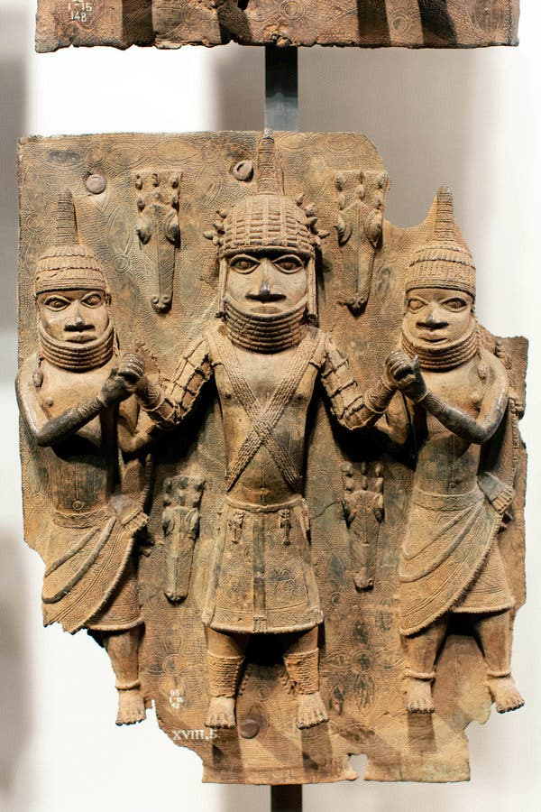
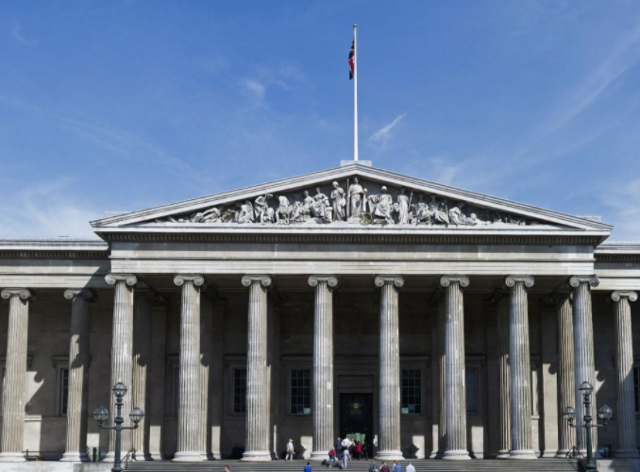
You can find antique Benin Bronzes in many of the West’s great museums, including the British Museum in London and the Metropolitan Museum of Art in New York.
There’s one place, however, where few of the original artifacts are found: Benin City, where they were made.

Slide 5
The Benin artefacts will be returned to the new Museum of Benin.
You have been asked to make drawings as records of some of the artefacts.
Notes:
Explain that this is a topical but imagined scenario – the British Museum have pages on their website that explain the situation https://www.britishmuseum.org/about-us/british-museum-story/objects-news/benin-bronzes
Discuss why drawings by an artist might be beneficial over photographs

Slide 6
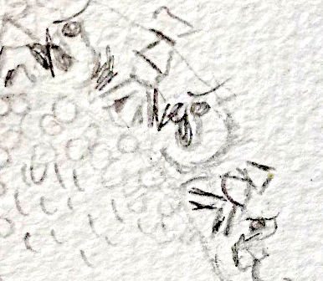
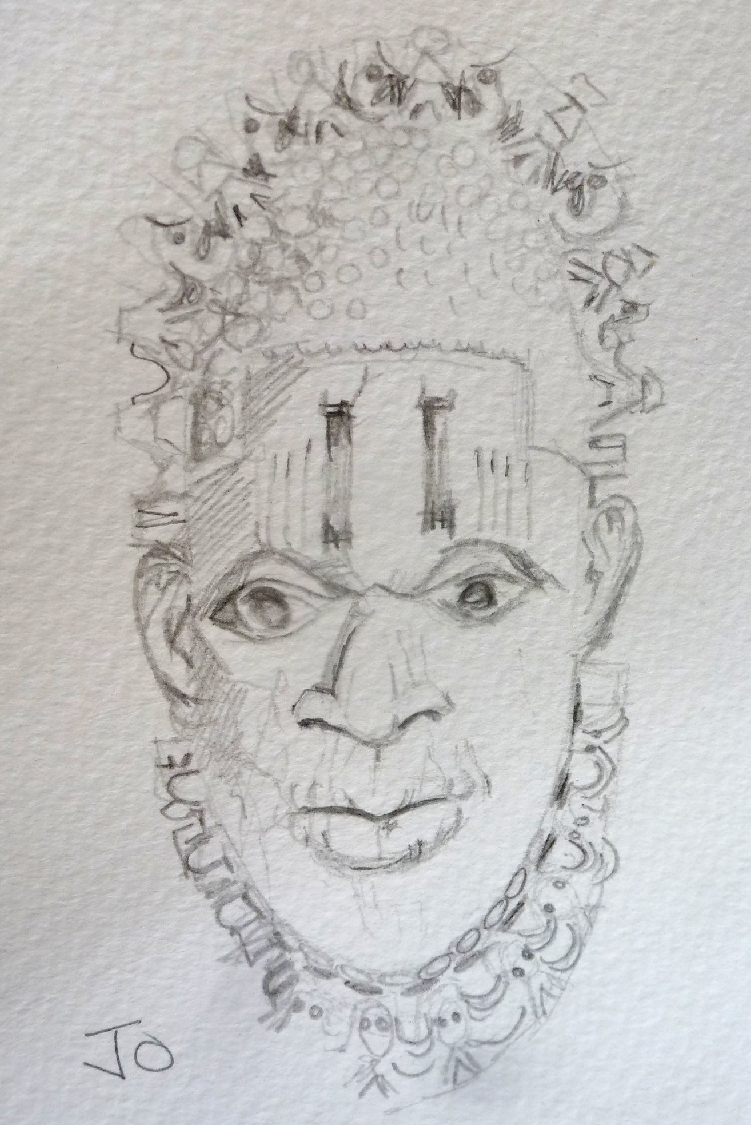
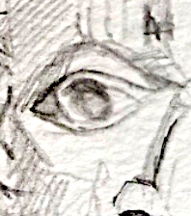
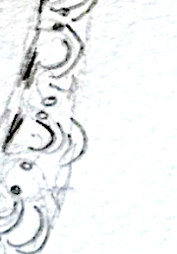
Exploded drawing
Detail on crown – Portuguese traders
Incisions
Detail on under chin - mudfish
Eyes & incision - iron
Notes:
Explain that Exploded Drawings can allow the viewer to see details at the same time as the whole image.
Talk about how the artist can decide which parts to emphasise and might include annotations to support drawings.

Slide 7
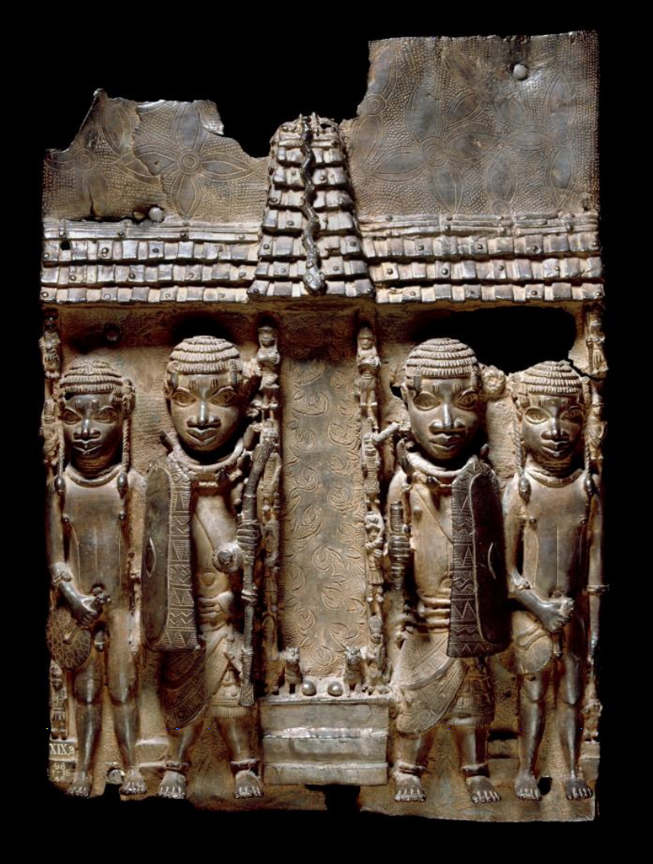
Charles Omorodion grew up in Benin City but now lives in Britain. He said that seeing the Benin Bronzes in the world’s museums fills him with pride, as they show visitors how great the Benin Kingdom had been.
He added, he also feels frustration and anger about them being kept outside his country.
Brass plaque showing the Oba of Benin with attendants Benin, Nigeria 16th century AD
Notes:
Discuss whether students believe the Benin objects should be kept or returned and the pros and cons.

Slide 8






Stay in touch…
The Primary Art Class
emily@theprimaryartclass.com

