Slide 1
Art Detectives

Slide 2
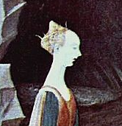
What do you see?
In this part of the painting I can see…

Slide 3
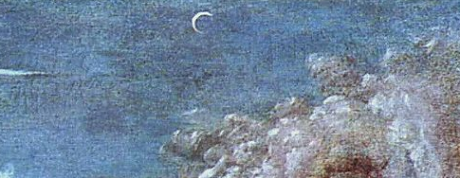
What do you see?
In this part of the painting I can see…

Slide 4
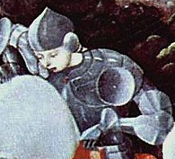
What do you see?
In this part of the painting I can see…

Slide 5
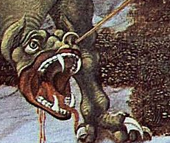
What do you see?
In this part of the painting I can see…

Slide 6
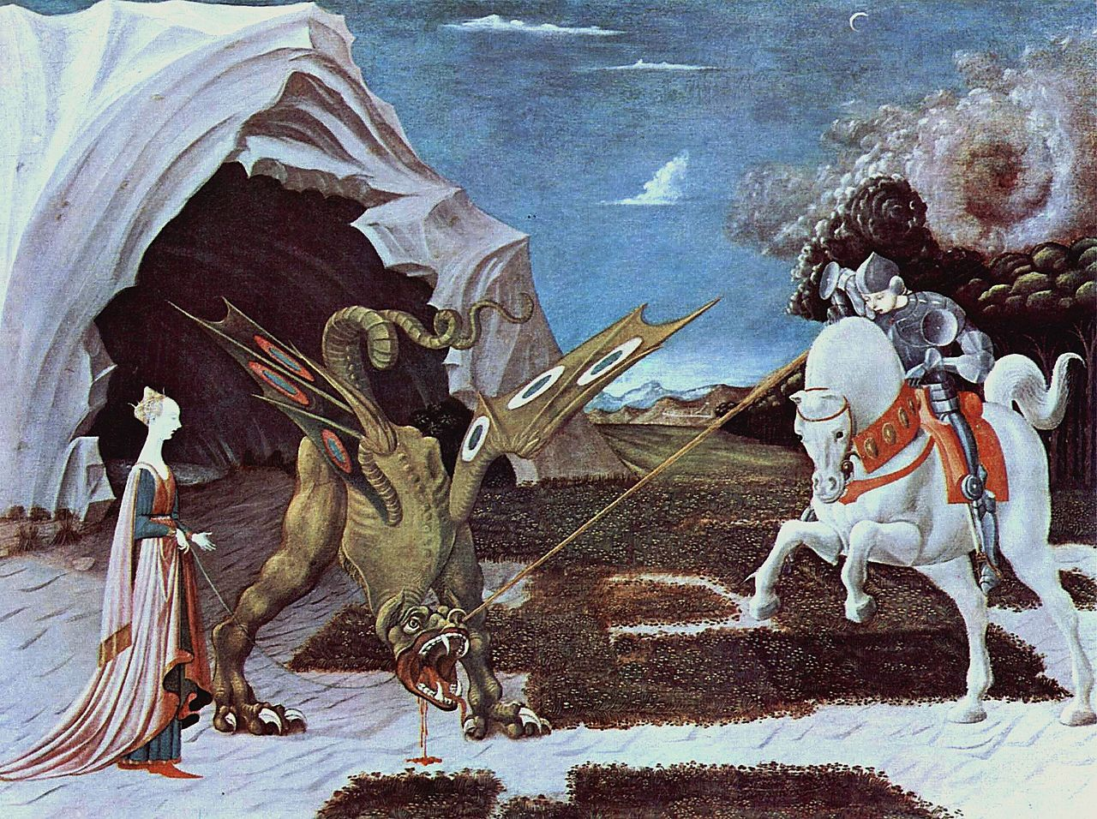
Paolo Uccello, 1460. Saint George and the dragon
Notes:
Zoom in on the artwork here:
https://www.nationalgallery.org.uk/paintings/paolo-uccello-saint-george-and-the-dragon
Describe what you can see:
Full teachers notes here form the NG https://www.nationalgallery.org.uk/media/31352/notes_uccello-st-george-dragon.pdf

Slide 7

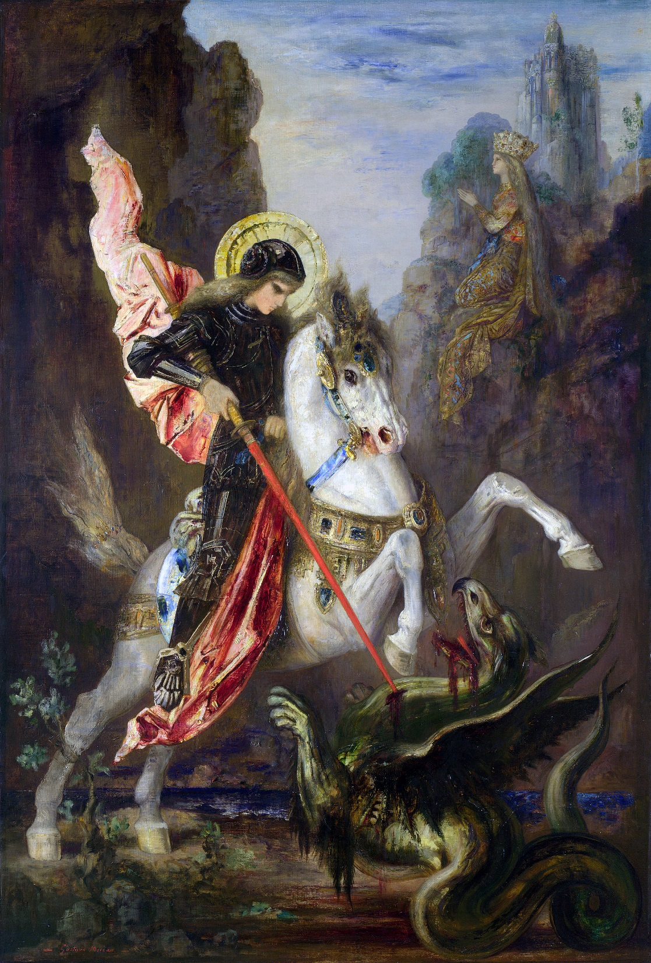
Saint George and the dragon
Paolo Uccello, 1460.
Compare & Contrast
Saint George and the Dragon
Gustave Moreau, 1889/1890
Notes:
Zoom in on the additional artwork here https://www.nationalgallery.org.uk/paintings/gustave-moreau-saint-george-and-the-dragon

Slide 8
Saint George and the Dragon
Gustave Moreau, 1889/1890

